Slide 1
The hitchhiker's guide to the Voxels
Don’t panic
Ushiostarfish

Slide 2
Motivation
Ray Tracing with Triangles
A lot of solutions
Embree, OptiX, DXR, VK_KHR_acceleration_structure, HIPRT
A lot of issues you may face in rendering
Degenerate polygons, self-intersections, no-manifold meshes…
Ray Tracing with Voxels?
How about using a dedicated acceleration structure & traversal?
Let’s try ☺
Custom Geometry in Ray Tracing SDKs?
They are not optimized for voxels
Example) Embree 55M voxels: 5 GB only for BVH ☹

Slide 3
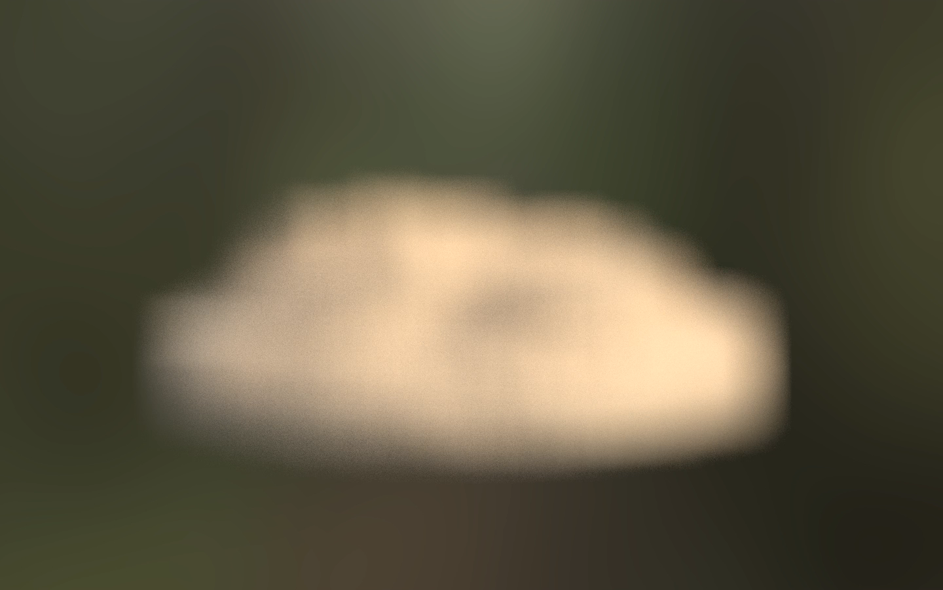

Slide 4
Voxelization

Slide 5
Voxelization of Triangles
Rasterization based
Cyril Crassin and Simon Green, “OpenGL Insights / Octree-Based Sparse Voxelization Using the GPU Hardware Rasterizer”
I DO NOT want to touch the rasterizer pipeline ☹
Compute based
Michael Schwarz, Hans-Peter Seidel, “Fast Parallel Surface and Solid Voxelization on GPUs”
Jacopo Pantaleoni, “ VoxelPipe: A Programmable Pipeline for 3D Voxelization”

Slide 6
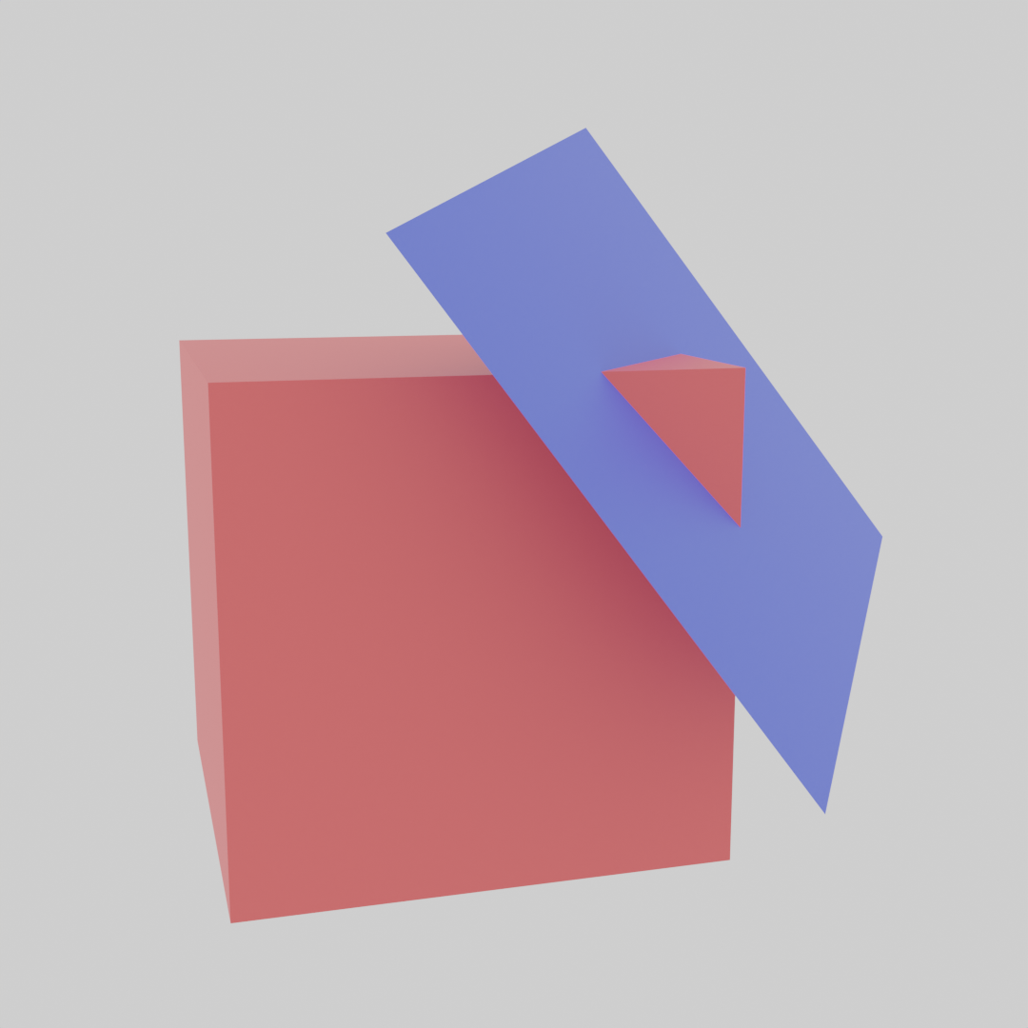
Voxel – Triangle collision detection
Voxelization: check if the voxel and triangle are overlapped
Two conditions
(condition 1) Triangle plane and the voxel are overlapped
(condition 2) 2d projected triangle and 2d projected voxel are overlapped for each axis ( X, Y, Z )
condition 1
condition 2

Slide 7
2d Triangle vs Box overlap test - Conservative
Most interior
(Positive)
Most interior
(Negative)
Use points called “critical points”
Check if the most interior point is inside
Critical Points for Conservative Voxelization
Note: the points are shifted to clarify its belongings

Slide 8












2d Triangle vs Box overlap test - Conservative
Critical points can be expressed by 2d projected position $p_{⊥}$and voxel size $Δp_{⊥}=\left(Δp_{x},Δp_{y}\right)$
Calculate the signed distance $d_{max}$ to the most interior point
$$n_{e}$$
$$p_{⊥}+Δp_{⊥}$$
$$n_{e}⋅p_{⊥}−n_{e}⋅v_{0}$$
$$p_{⊥}+(0,Δp_{y})$$
$$d_{max}$$
$$n_{e}⋅\left(p_{⊥}+\left(0,Δp_{y}\right)\right)−n_{e}⋅v_{0}$$
Max value of these =
$$d_{max}$$
$$n_{e}⋅\left(p_{⊥}+\left(Δp_{x},0\right)\right)−n_{e}⋅v_{0}$$
$$p_{⊥}+(Δp_{x},0)$$
$$p_{⊥}$$
$$n_{e}⋅\left(p_{⊥}+Δp_{⊥}\right)−n_{e}⋅v_{0}$$
$$v_{0}$$
$$d_{max}=n_{e}⋅p_{⊥}+max\left(n_{e,x}Δp_{x},0\right)+max\left(n_{e,y}Δp_{y},0\right)−n_{e}⋅v_{0}$$
Constant. Calculate just once per edge.

Slide 9

2d Triangle vs Box overlap test - Conservative
2d overlap ( conservative ) =
$$∀_{d}∈edges,0≤d_{max}$$
$$d_{max}=n_{e}⋅p_{⊥}+max\left(n_{e,x}Δp_{x},0\right)+max\left(n_{e,y}Δp_{y},0\right)−n_{e}⋅v_{0}$$

Slide 10
2d Triangle vs Box overlap test – corner caseS
There are corner cases in which the test shows “overlap” but it is not true
It can be completely filtered by additional 2d bounding box test
The subsequent algorithm in this presentation does need the test
2d bounding box test is implicitly taken into account
You may need an extra 2d bounding box test if you use it for other purposes
A corner case – false positive

Slide 11
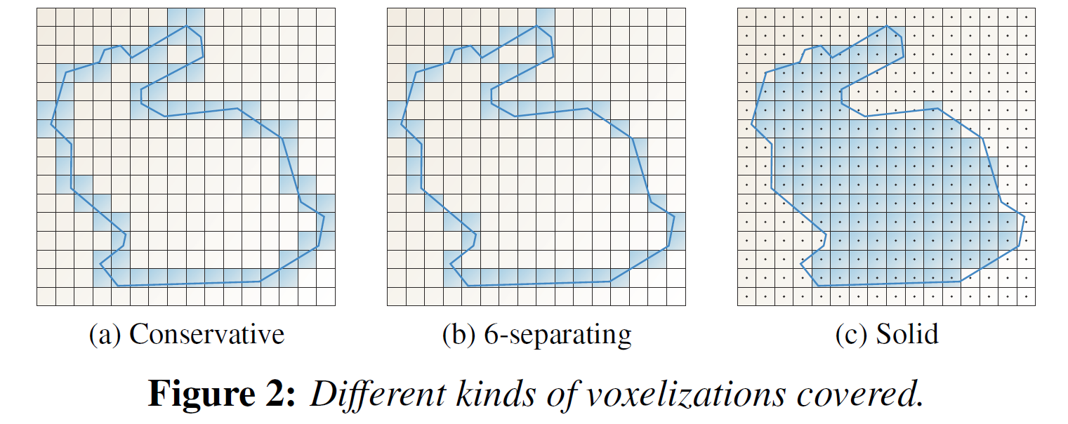
2d Triangle vs Box overlap test – 6 Separating
Another variant of voxelization
Often closer to the original geometry
Same rule but just different “Critical Points”
Most interior
(Positive)
Most interior
(Negative)
Critical Points for
6-separating Voxelization
“Fast Parallel Surface and Solid Voxelization on GPUs”

Slide 12



2d Triangle vs Box overlap test – 6 Separating
2d overlap ( 6-separating ) =
$$∀_{d}∈edges,0≤d_{max}$$
$$d_{max}=n_{e}⋅p_{⊥}+n_{e}⋅\left(\frac{1}{2}Δp_{⊥}−v_{0}\right)+\frac{1}{2}Δp max\left(\left|n_{e,x}\right|,\left|n_{e,y}\right|\right)$$
Same with Conservative
Constant. Calculate just once per edge
Where $Δp_{x}=Δp_{y}=Δp$
As an implementation-wise advantage, the test algorithm can be the same
Just switching the constant terms ☺

Slide 13
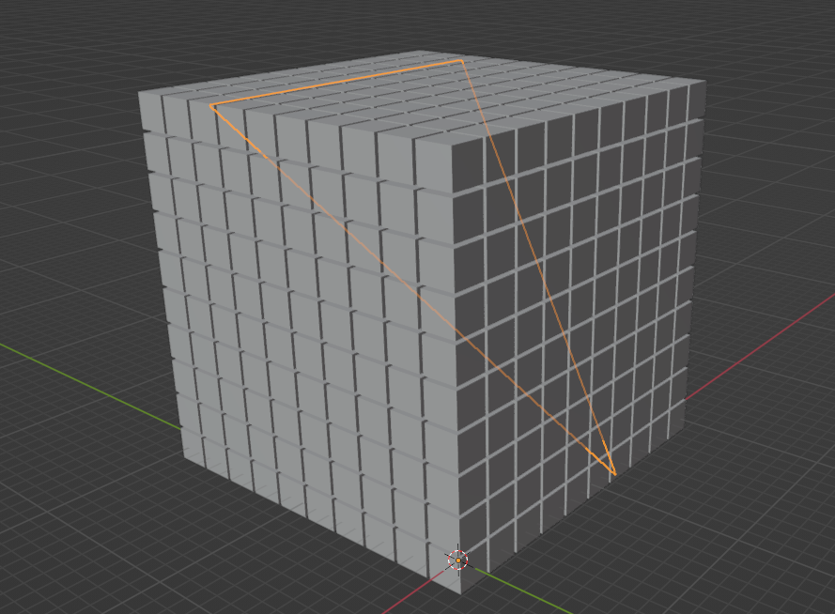
A Problem of Voxel visiting
To visit all voxels in the bounding box of a triangle
Too many voxels to check!!!! ☹

Slide 14
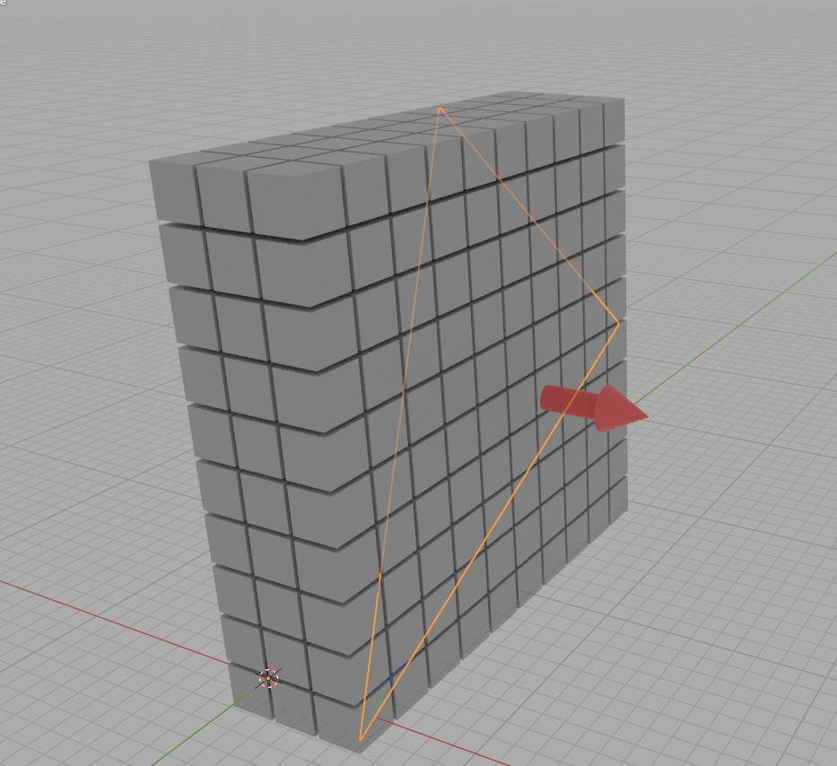
Minimizing Number of voxels to visit
Choose “major” axis
Rasterize them in 2D space
Major Axis ( X )
Rasterize in 2D

Slide 15
Rasterization
Process voxels for each line
The first axis-x range is trivial
But for the second axis-y?

Slide 16








The Edge function
$d_{max}$ can be considered a linear function
$$p_{x}$$
$$0<d_{max}\left(p_{y}\right)$$
$$0<d_{max}\left(p_{y}\right)$$
$$d_{max}=n_{e}⋅p+d_{const}$$
$$=n_{e,x}⋅p_{x}+n_{e,y}⋅p_{y}+d_{const}$$
$$0>d_{max}\left(p_{y}\right)$$
$$d_{max}\left(p_{y}\right)=n_{e,x}⋅p_{x}+n_{e,y}⋅p_{y}+d_{const}$$
$$0>d_{max}\left(p_{y}\right)$$

Slide 17




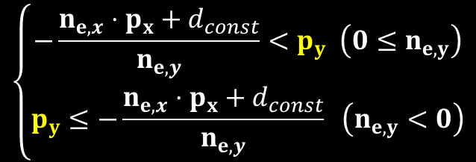

The Edge function
We can obtain a half interval of $p_{y}$ from $0≤d_{max}\left(p_{y}\right)$
We can obtain the min and max by combining 3 half intervals ☺
$$0≤n_{e,x}⋅p_{x}+n_{e,y}⋅p_{y}+d_{const}$$
$$−n_{e,x}⋅p_{x}−d_{const}≤n_{e,y}⋅p_{y}$$
$$p_{y,max}$$
$$\left\{\begin{aligned}−\frac{n_{e,x}⋅p_{x}+d_{const}}{n_{e,y}}<p_{y} \left(0≤n_{e,y}\right) \\ p_{y}≤−\frac{n_{e,x}⋅p_{x}+d_{const}}{n_{e,y}} \left(n_{e,y}<0\right)\end{aligned}\right.$$
$$p_{y,min}$$

Slide 18





The Edge function – A corner case
$n_{e,y}=0$ case?
$$n_{e,y}=0$$
$$0≤n_{e,x}⋅p_{x}+n_{e,y}⋅p_{y}+d_{const}$$
$$0≤n_{e,x}⋅p_{x}+d_{const}$$
$$−d_{const}≤n_{e,x}⋅p_{x}$$
All reject voxels it is false. Otherwise, just skip the edge.

Slide 19


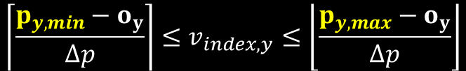

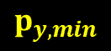







The Edge function - Voxels
A condition for valid voxels
$p_{y,min}≤p_{y}≤p_{y,max}$
$$p_{0,y}<p_{y,min}$$
$$p_{y,min}$$
$$p_{y,max}$$
Voxel Index Range:
$$o$$
$$p_{1}$$
$$p_{2}$$
$$p_{3}$$
$$p_{4}$$
$$\left\lceil \frac{p_{y,min}−o_{y}}{Δp}\right\rceil ≤v_{index,y}≤\left\lfloor \frac{p_{y,max}−o_{y}}{Δp}\right\rfloor$$
[0]
[1]
[2]
[3]
[4]
+Y
$o$: The voxel origin

Slide 20
DEPTH direction
We have already minimized voxels in 2d
What about the last axis?
Major Axis ( X )
Rasterize in 2D

Slide 21



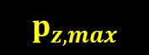

DEPTH direction - Conservative
There are minimum and maximum z to overlap between the plane and edges-z
$$p_{z,min}$$
$$p_{z,max}$$
$$k_{x}=−\frac{n_{x}}{n_{z}}$$
$$k_{y}=−\frac{n_{y}}{n_{z}}$$
$$v_{0}$$
A point on a plane
$$p_{z,min}=k_{x}o_{x}+k_{y}o_{y}−k_{x}v_{0,x}−k_{y}v_{0,y}+v_{0,z}+Δp\left\{max\left(k_{x},0\right)+max\left(k_{y},0\right)\right\}$$
$$p_{z,max}=k_{x}o_{x}+k_{y}o_{y}−k_{x}v_{0,x}−k_{y}v_{0,y}+v_{0,z}+Δp\left\{min\left(k_{x},0\right)+min\left(k_{y},0\right)\right\}$$
$o$: The voxel origin
Constant. Calculate just once per triangle
Notes:
Quadrangular prism

Slide 22
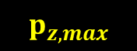

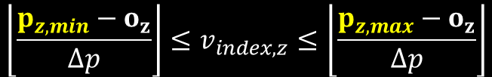
DEPTH direction - Conservative
There are minimum and maximum z to overlap between the plane and edges-z
Just check the depth overlap ☺
Always less than or equal to 3 voxels as we chose a major axis for z
$$p_{z,min}$$
$$p_{z,max}$$
No depth overlap
No depth overlap
$$\left\lfloor \frac{p_{z,min}−o_{z}}{Δp}\right\rfloor ≤v_{index,z}≤\left\lfloor \frac{p_{z,max}−o_{z}}{Δp}\right\rfloor$$
$o$: The voxel origin

Slide 23
DEPTH direction – 6-separating
Check if the plane is located between critical points
Don’t have to handle a plane that is tilted to the z-axis by more than 45 degrees
Remember we chose a major axis for z

Slide 24


DEPTH direction – 6-separating
Only the center axis is matter
$$k_{x}=−\frac{n_{x}}{n_{z}}$$
$$k_{y}=−\frac{n_{y}}{n_{z}}$$
$$p_{z,6−sep}$$
$$p_{z,6−sep}=k_{x}o_{x}+k_{y}o_{y}−k_{x}v_{0,x}−k_{y}v_{0,y}+v_{0,z}+\frac{1}{2}Δp\left(k_{x}+k_{y}\right)$$
Constant. Calculate just once per triangle

Slide 25


DEPTH direction – 6-separating
Just 1 or 2 voxels
For conservative voxelization, it might be better to handle the case 2
$$v_{index,z}=\left\lfloor \frac{p_{z,6−sep}−o_{z}}{Δp}\right\rfloor$$
$$v_{index,z}=\left\{\left\lfloor \frac{p_{z,6−sep}−o_{z}}{Δp}\right\rfloor −1,\left\lfloor \frac{p_{z,6−sep}−o_{z}}{Δp}\right\rfloor \right\}$$
Case 1
Case 2

Slide 26
Voxelization – high level algorithm
calculate constant terms for the triangle
int2 xrange = x range from bounding box of the triangle
for( int x = xrange.x; x <= xrange.y; x++ )
{
int2 yrange = y range from 2d projected edges and the bounding box of the triangle
for( int y = yrange.x; y <= yrange.y; y++ )
{
int2 zrange = z range from plane overlap
for( int z = zrange.x; z <= zrange.y; z++ )
{
if( 2d overlap test for side axis ( x, y ) )
{
report a voxel
}
}
}
}

Slide 27
Voxelization – high level algorithm
(condition 2)
2d projected triangle and 2d projected voxel are overlapped for each axis ( X, Y, Z )
calculate constant terms for the triangle
int2 xrange = x range from bounding box of the triangle
for( int x = xrange.x; x <= xrange.y; x++ )
{
int2 yrange = y range from 2d projected edges and the bounding box of the triangle
for( int y = yrange.x; y <= yrange.y; y++ )
{
int2 zrange = z range from plane overlap
for( int z = zrange.x; z <= zrange.y; z++ )
{
if( 2d overlap test for side axis ( x, y ) )
{
report a voxel
}
}
}
}

Slide 28
Voxelization – high level algorithm
calculate constant terms for the triangle
int2 xrange = x range from bounding box of the triangle
for( int x = xrange.x; x <= xrange.y; x++ )
{
int2 yrange = y range from 2d projected edges and the bounding box of the triangle
for( int y = yrange.x; y <= yrange.y; y++ )
{
int2 zrange = z range from plane overlap
for( int z = zrange.x; z <= zrange.y; z++ )
{
if( 2d overlap test for side axis ( x, y ) )
{
report a voxel
}
}
}
}
(condition 1) Triangle plane and the voxel are overlapped

Slide 29
Acceleration structure

Slide 30
Octree
Papers
J. Baert, A. Lagae and Ph. Dutré, “Out-of-Core Construction of Sparse Voxel Octrees”
Martin P¨atzold and Andreas Kolb, “Grid-Free Out-Of-Core Voxelization to Sparse Voxel Octrees on GPU”
The target geometries are voxels
An octree leaf == a voxel
I focus on “In core” algorithm for simplicity

Slide 31
Key component: Morton Code
Linearization of a grid
Construction
Get the binary index for each axis
Interleave the bits
[3]
X = 11
Y = 10
M = 1101
[2]
Y
[1]
X = 10
Y = 00
M = 0100
[0]
[0]
[1]
[2]
[3]
X

Slide 32
Key component: Morton Code
X = 10
Y = 11
M = 1110
Check if two Morton codes have the same parent
Easy to get parent space by x >> 2
Just compare higher bits ☺
Same!
[3]
X = 11
Y = 10
M = 1101
[2]
Y
Different..
[1]
X = 10
Y = 00
M = 0100
[0]
[0]
[1]
[2]
[3]
X

Slide 33
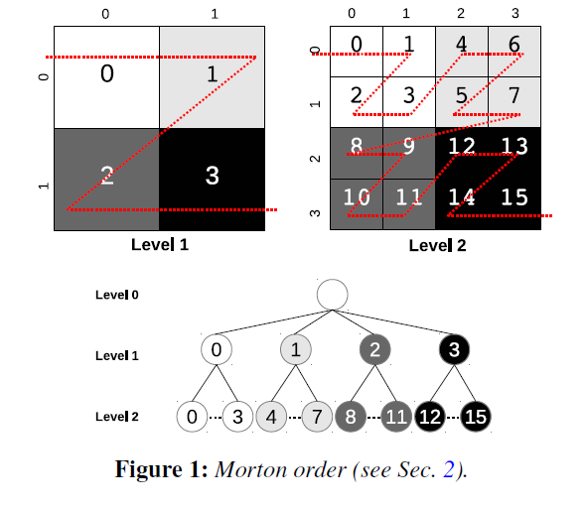
Bottom-up Octree Construction by Morton Code
A voxel can be expressed by a Morton code
Group by their parent
Voxels with the same parent are always next to each other
Voxelized Morton Codes
10
9
1
7
8
3
Sort
1
3
7
8
9
10
Group by Parent Space
Octree node
Octree node
Octree node
Create octree intermediate nodes
Emit their parents
0
1
2
2d example. From “Out-of-Core Construction of Sparse Voxel Octrees”
Loop until level 0

Slide 34
Octree Compression

Slide 35
Node Reuse
Paper
Viktor Kampe, Erik Sintorn, Ulf Assarsson, “High Resolution Sparse Voxel DAGs”
Remove Octree Node Redundancy
Example) Leaf Nodes
Level n - 2
Level n - 2
Level n - 1
Level n - 1
The same data ☹
No duplications ☺

Slide 36
Bottom-up compression
Duplication removals in a bottom-up fashion
Possible to detect duplications by just checking child pointers ☺
For 2 nodes, their child pointers are equal $⇔$ The tree structures are the same
A unique tree has a unique pointer
Example) 1 more upper node
Level n - 3
Level n - 3
Compare Pointers
Level n - 2
Level n - 2
Level n - 1
Level n - 1
The same data ☹
No duplications ☺

Slide 37
Bottom-up Compression during Construction
Duplication removal during construction
Straight forward integration
Voxelized Morton Codes
10
9
1
7
8
3
Sort
1
3
7
8
9
10
Group by Parent Space
Octree node
Octree node
Octree node
Create octree intermediate nodes
Duplication Removal
0
1
2
Emit their parents
Loop until level 0

Slide 38
Duplication removal on the GPU
Linear Probing looks promising approach
But the size of the key is large - child pointers x 8 + mask
Partially-locking linear probing
struct OctreeNode
{
uint8_t mask;
uint32_t children[8];
};

Slide 39
Partially-locking linear probing
home
home = hash( newNode ) % tableSize
int node;
for( int i = 0 ; i < k ; i++ )
{
int location = ( home + i ) % tableSize;
uint32_t nodeInTable = atomicCAS( &table[location], 0, LOCK );
__threadfence();
if( nodeInTable == 0 ) // succeeded to lock
{
node = createNode();
__threadfence();
atomicExch( &table[location], node );
break;
}
else if( nodeInTable == LOCK )
{
i--; // try again
}
else
{
equal = check equality nodeInTable and newNode
if( equal )
{
node = nodeInTable
break;
}
}
}
occupied

Slide 40

Partially-locking linear probing
home
home = hash( newNode ) % tableSize
int node;
for( int i = 0 ; i < k ; i++ )
{
int location = ( home + i ) % tableSize;
uint32_t nodeInTable = atomicCAS( &table[location], 0, LOCK );
__threadfence();
if( nodeInTable == 0 ) // succeeded to lock
{
node = createNode();
__threadfence();
atomicExch( &table[location], node );
break;
}
else if( nodeInTable == LOCK )
{
i--; // try again
}
else
{
equal = check equality nodeInTable and newNode
if( equal )
{
node = nodeInTable
break;
}
}
}
Lock the insertion point to avoid another thread

Slide 41
Partially-locking linear probing
home
home = hash( newNode ) % tableSize
int node;
for( int i = 0 ; i < k ; i++ )
{
int location = ( home + i ) % tableSize;
uint32_t nodeInTable = atomicCAS( &table[location], 0, LOCK );
__threadfence();
if( nodeInTable == 0 ) // succeeded to lock
{
node = createNode();
__threadfence();
atomicExch( &table[location], node );
break;
}
else if( nodeInTable == LOCK )
{
i--; // try again
}
else
{
equal = check equality nodeInTable and newNode
if( equal )
{
node = nodeInTable
break;
}
}
}
Allocate a node, and set node to the table
Note: This is a code for ITS environment

Slide 42
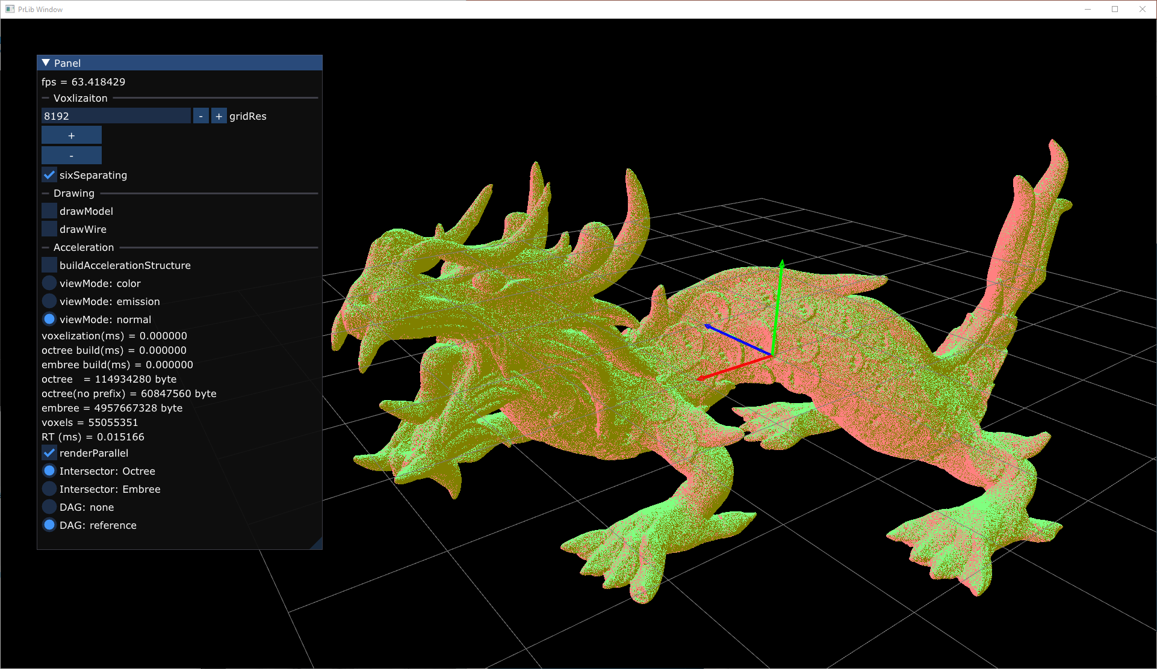

How Small is it?
Asian Dragon
${8192}^{3}$ Resolution
55M voxels
955M bytes for naive octree
61M bytes for a compressed octree ☺
5G bytes with Embree(4.1.0) UserGeometry
struct OctreeNode
{
uint8_t mask;
uint32_t children[8];
};
Stupidly simple representation for both octree

Slide 43
Ray Traversal

Slide 44
Papers
John Amanatides and Andrew Woo, “A Fast Voxel Traversal Algorithm”
For uniform grid
Mark Agate, Richard L. Grimsdale and Paul F. Lister, “The HERO Algorithm for Ray-Tracing Octrees”
J. Revelles, C. Urena, M. Lastra, “An Efficient Parametric Algorithm for Octree Traversal”
The HERO Algorithm is simplified
Easier explanation: https://chiranjivi.tripod.com/octrav.html

Slide 45








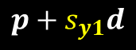


Octree Traversal
Slab test
$$x_{0}$$
$$x_{1}$$
$s_{0}=$ $\frac{x_{0}−p_{x}}{d_{x}}$
$$p+s_{y1}d$$
$$p+s_{x1}d$$
$$y_{1}$$
$s_{1}=$ $\frac{x_{1}−p_{x}}{d_{x}}$
$$p+s_{x0}d$$
$$y_{0}$$
$$p+td$$
$$p+s_{y0}d$$

Slide 46
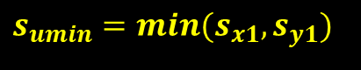






Octree Traversal
Slab test
$$x_{0}$$
$$x_{1}$$
$$y_{1}$$
$$s_{umin}=min(s_{x1},s_{y1})$$
$$s_{lmax}=max(s_{x0},s_{y0})$$
$$y_{0}$$
$$p+td$$

Slide 47
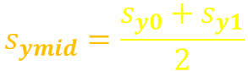



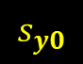
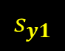
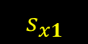

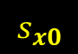

CHILD Voxel Traversal
The first crossed node
$$x_{0}$$
$$x_{1}$$
$$s_{y1}$$
$$y_{1}$$
$$s_{x1}$$
$$s_{ymid}=\frac{s_{y0}+s_{y1}}{2}$$
$$s_{xmid}=\frac{s_{x0}+s_{x1}}{2}$$
$$y_{0}$$
$$s_{y0}$$
$$s_{x0}$$

Slide 48







CHILD Voxel Traversal
The first crossed node
Compare $s_{lmax}$ and $s_{xmid}$, $s_{ymid}$
Left
$$s_{xmid}$$
Right
$$s_{lmax}$$
$$s_{lmax}$$
$$s_{xmid}$$
$$s_{lmax}<s_{xmid}$$
$$s_{xmid}<s_{lmax}$$

Slide 49






CHILD Voxel Traversal
The first crossed node
Compare $s_{lmax}$ and $s_{xmid}$, $s_{ymid}$
Top
$$s_{lmax}$$
$$s_{ymid}$$
$$s_{lmax}$$
$$s_{ymid}$$
Bottom
$$s_{lmax}<s_{ymid}$$
$$s_{ymid}<s_{lmax}$$

Slide 50

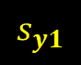




CHILD Voxel Traversal
What’s the next node?
Choose the closest distance to the next planes
$$s_{y1}$$
$$s_{xmid}$$
$$s_{xmid}$$
$$s_{ymid}$$
$s_{xmid}$< $s_{y1}$
$$s_{ymid}<s_{xmid}$$
The next is X
The next is Y

Slide 51
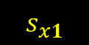

CHILD Voxel Traversal
What’s the next node?
Choose the closest distance to the next planes
$$s_{y1}$$
$$s_{x1}$$
Either way, no children anymore. Finish traversal.

Slide 52
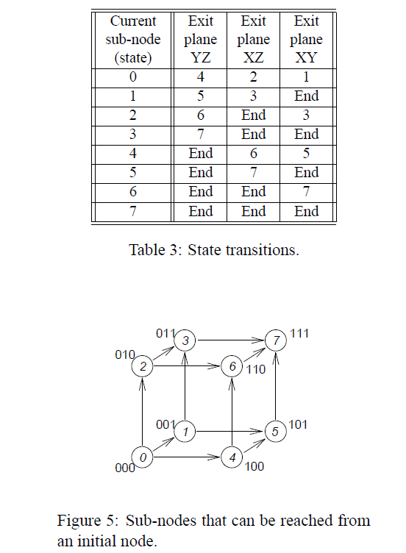
State Transitions?
Table-based management is proposed in “An Efficient Parametric Algorithm for Octree Traversal
But it is not necessary in my experience because you can just keep the directions you have moved as bits
for( ;; )
{
// find minimum( x1, y1, z1 ) for next hit
uint32_t mv =
x1 < y1 ? ( x1 < z1 ? 1u : 4u ) : ( y1 < z1 ? 2u : 4u );
// The move bit is yet empty, you can move to the direction
bool hasNext = ( cur.childMask & mv ) == 0;
...
// mark your movement
cur.childMask |= mv;

Slide 53
“Push all Hit Children” VS “save state and go down”
“Save state and go down” has multiple advantages
Less stack usage ( maximum == depth of the octree )
The code is shorter as no need to reverse children to push
Only “moved bits” is the variable for state management
node = ...
while()
{
next = node.findNextCrossedChild()
if( node.mayHaveNext() )
{
push( node )
}
if( next is valid )
{
node = next
}
else
{
node = pop()
}
}
node = ...
while()
{
hitChildren = node.findCrossedChildren()
foreach( child in reverse( hitChildren ) )
{
push( child )
}
node = pop()
}
Push all hit children
Save state and go down

Slide 54
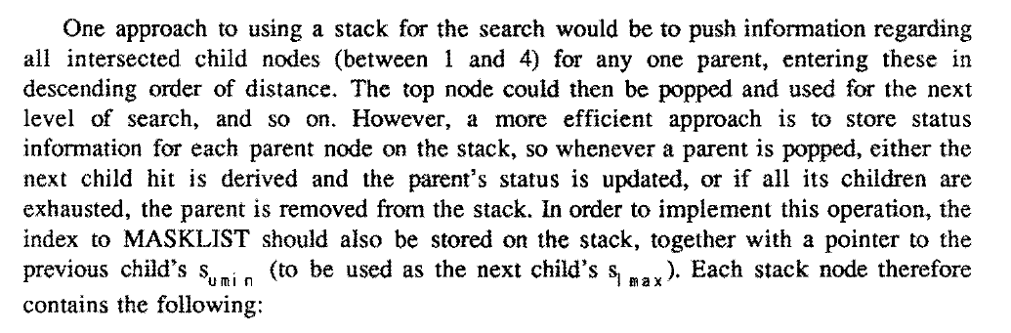
“Push all Hit Children” VS “save state and go down”
“Save state and go down” has multiple advantages
Less stack usage ( maximum == depth of the octree )
The code is shorter as no need to reverse children to push
Only “moved bits” is the variable for state management
node = ...
while()
{
next = node.findNextCrossedChild()
if( node.mayHaveNext() )
{
push( node )
}
if( next is valid )
{
node = next
}
else
{
node = pop()
}
}
node = ...
while()
{
hitChildren = node.findCrossedChildren()
foreach( child in reverse( hitChildren ) )
{
push( child )
}
node = pop()
}
Sec. 4 in “The HERO Algorithm for Ray-Tracing Octrees”
Push all hit children
Save state and go down

Slide 55
A tip: When you can stop traversal
The traversal order is always ideal
You can stop traversal immediately after you find a voxel in the deepest level☺
Pushed node in the stack can be totally skipped
2
3
Hit!
1

Slide 56


A tip: Back Voxel Skip
Voxels behind the ray can be skipped
When the next $s_{umin,next}$ is negative, the current voxel is totally behind
You don’t have to traverse into the voxel ☺
next
$$s_{umin,next}<0$$
current

Slide 57

Generalizing for Rays with Negative Directions
The traversal algorithm so far assumes all components of ray direction $d$ are positive
How to handle negative rays?
positive
negative

Slide 58
Mirroring
X flip
Mirror image around the center of the octree
Do it for each axis
What about children’s order?
They can be reordered by XOR bit operation
Just apply “flip bits” to the child index
Y flip
10
11
index ^ 10
00
01
index ^ 01
... = node.children[ index ^ flipBits ];

Slide 59
Voxel Attribute Support

Slide 60
Voxel Attribute Support
DAG compression is great
Simple bottom-up compression
Significantly reduce memory
… but what about colors?
Attributes per voxels can be useful for shading
DAG Octree shares redundant nodes but it is hard to share colored nodes because of spatially varying values
A paper elegantly resolved
Dan Dolonius, Erik Sintorny, Viktor Kampezand Ulf Assarsson, “Compressing Color Data for Voxelized Surface Geometry”

Slide 61
Dynamic Voxel Indexing
Embed “the number of voxels in children” to each node
Count all left children’s voxels when you traverse
8
0
3
1
2
2
Level n - 1
1
1
1
1
1
1
1
1
The number is the index of the voxel ☺

Slide 62
Dynamic Voxel Indexing
Embed “the number of voxels in children” to each node
Count all left children’s voxels when you traverse
Number of Voxels can be shared unlike colors in DAG
Attribute data is totally independent from Octree
8
3
2
3
2
2
4
Level n - 1
1
1
1
1
1
1
1
4
The number is the index of the voxel ☺

Slide 63

Dynamic Voxel Indexing
struct OctreeNode
{
uint8_t mask;
uint8_t pads[3];
uint32_t children[8];
};
The paper mentioned the padding bits on an octree node can be used
However, there are a few disadvantages to this approach
The total number of voxels has to be less than $2^{24}$
You have to count all of the left children during the traversal
It can not be cached in the stack because traversal order is not sequential
It requires fetching data from children
It is expensive specifically on the GPU
31
5
3
9
3
5
5
1
1
$$5+3+9+3+5+5+1=31$$

Slide 64
Alternative Approach
struct OctreeNode
{
uint8_t mask;
uint32_t children[8];
uint32_t nVoxelsPSum[8];
};
Prefix Sum can be stored in the parent node
Counting is replaced to look up the table ☺
No memory access to the children☺
It almost doubles octree memory ☹
But it is a trade-off
Exclusive Prefix Sum
0
5
8
17
20
25
30
31
31
8

Slide 65
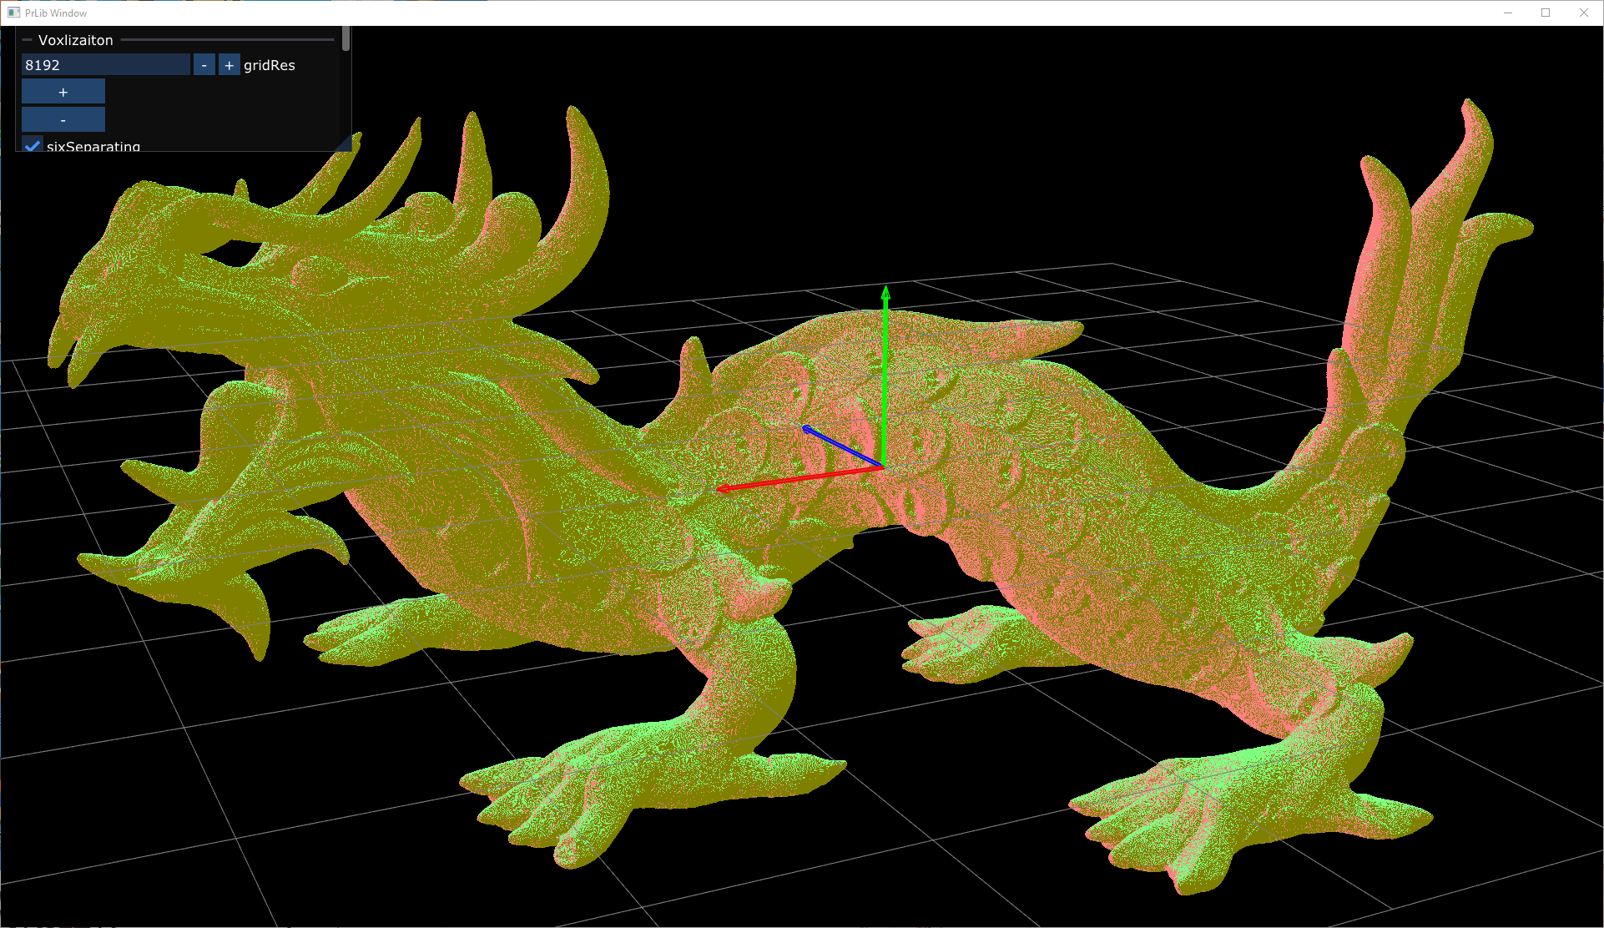


Performance - CPU
${2048}^{3},{4096}^{3},{8192}^{3}$ Resolutions
vs Embree user geometry, single threaded
Asian Dragon( ${8192}^{3}$ )
${8192}^{3}$ Resolution
55M voxels
Notes:
Note that these flag are disabled for CPU
//#define ENABLE_EMBEDED_MASK 1
//#define SMALL_STACK 1

Slide 66

Performance - GPU
Asian Dragon( ${8192}^{3}$ )
${8192}^{3}$ Resolution
55M voxels
Primary Ray Casting ( 1920 x 1080 )
RX 7900 XTX, RTX 3090 Ti
2 ms for primary for both

Slide 67
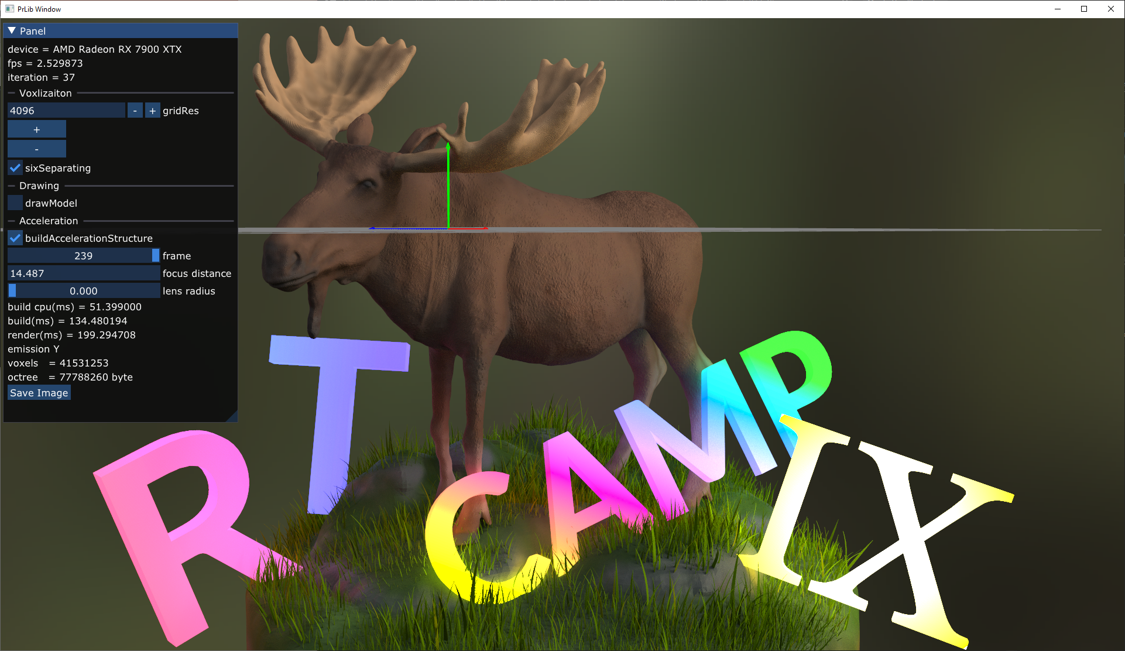

Performance - GPU
RT Camp Scene( ${8192}^{3}$ )
${4096}^{3}$ Resolution
41M voxels
8 bounce diffuse GI ( 1920 x 1080 )
IBL shadow rays
No shadow rays for emissive voxels
RX 7900 XTX
~ 200 ms / 16 spp ( 12.5 ms / sample )
~ 135 ms for voxelization and build octree

Slide 68
Conclusion
Tons of amazing papers about voxels!
Cool ideas
Voxelization, octree construction, ray traversal
Easy to implement, efficient execution
Gives us a lot of new insights
Is triangle really for you?

